Slide 1
New Hire Orientation

Slide 2
Health and Retirement Benefits

Slide 3
Retirement
Must make a decision today regarding your retirement plan!
2 Options:
Maryland State Retirement and Pension System (MSRP)
Defined Benefits Plan
Optional Retirement Plan (ORP)
Defined Contribution Plan

Slide 4
Maryland State Retirement and Pension System (MSRP)
Mandatory employee 7% contribution
Invested by MSRP Board of Trustees
Defined Benefit Plan:
Ordinary disability and Accidental disability, Death
benefits, Cost of Living Increases periodically
Must be here 10 years to be fully vested, unless prior state service before 7/1/2011
Limited portability among certain governmental agencies within the State of Maryland
Notes:
-

Slide 5
Maryland State Retirement and Pension System (MSRP)
Ordinary Disability Retirement
-Must be permanently disabled and have 5 or more years of eligible service
Accidental Disability Retirement
-Must be permanently and totally disabled as a direct
result of a job related injury

Slide 6
How Benefits Are Determined and Paid with MSRP
Benefits Determined By a Formula
-Fixed percentage of your years of credible service
-Average Final Salary X the multiplier (.018) X years of serice
How Benefits Are Paid
-Single-Life Annuity (Return of a single payment to your survivor(s) at your death)
-Dual-Life Annuity (A continuing monthly payment after your death to your surviving beneficiary)

Slide 7
Maryland State Retirement and Pension System (MSRP)
Normal Service Retirement
-Age 65 + 10 or more years of service
-Factor of 90: Years of service plus your age must equal 90
Early Retirement
-Age 60 + 15 or more years of service
- 6% annual reduction if less than 65

Slide 8
Optional Retirement Plan (ORP)
Defined Contribution Plan
Available only for exempt employees
State Contributes 7.25% of your base salary
Choice of Fidelity or TIAA
Immediately vested
Portable plan
Employee cannot make a contribution to this plan
If employees wish to make contributions, they would need to get a supplemental plan ( Fidelity, TIAA, Nationwide)
Notes:
-Defined Contribution plan
-State contributes 7.25% of your base salary
-You can choose Fidelity or TIAA
-Immediately vested
-Self directed plan which allows you to manage your own financial portfolio or the retirement program will manage for you
-Plan can be portable to other employers’ retirement programs
-Irrevocable decision if you go to the ORP plan.

Slide 9
Law Enforcement Officers’ Pension System (LEOP)
Mandatory employee 7% contribution
Invested by MSRP Board of Trustees
Eligible employees of the program can retire at the age of 50 years old
You must have 25 years of service

Slide 10
Health Benefits
As an employee, the health benefits available to you represent a significant component of your compensation package. They also provide important protection for your and your family.
Guide to Your Health Benefits
Notes:
I’m delighted to go over your Benefits Package with your employment here at BSU, which represents a significant component of your COMPENSATION PACKAGE.
The State of Maryland provides a generous benefit package to eligible employees and retirees with a wide range of benefit options from healthcare to income protection.
I’ll be discussing your
Medical Benefits (Health, Dental, Vision, Prescription Drugs) Term Life Insurance
Accidental Death & Dismember ship Insurance
Flexible Spending Accounts
Tuition Remision

Slide 11
Health Benefit Options
When Coverage Begins
As a New-Hire or Newly Eligible:
1st of the month following the date of hire
Health benefit enrollment is completed through Workday
Login information will be sent in 2 weeks (if delay, contact HR)
Must provide supporting documentation for dependents (birth certificate, state official marriage certificate) within 60 days of entry-on-duty through SPS Workday
Notes:
-Benefit deductions will be taken out either the 1st of 16th of the month, depending on when your enrollment is processed by the state. If you go to the doctor during the waiting period for your benefits to be taken into effect, we can make a retro back to your date of service and you will pay a check for the previous missed pay period deductions.
-Please provide us with the official marriage license and birth certificates, you and your dependent will not be covered until the State receives those documents.
-After 60 days, you will have to wait for the open enrollment period to enroll.

Slide 12
Health Benefit Options
When Coverage Begins
Qualifying Event:
A change in your life that can make you eligible for
a special Enrollment Period to enroll in health
coverage.
Examples:
Marriage
Divorce
Birth of a child
A Promotion

Slide 13
Medical Plan Options
You have 5 Medical Plans to choose from (PPO, EPO or IHM)
Two Preferred Provider Organization (PPO) Plans:
CareFirst BlueCross BlueShield PPO
United Healthcare PPO
Two Exclusive Provider Organization (EPO) Plans:
CareFirst BlueCross BlueShield EPO
United Healthcare EPO
One Integrated Health Model (IHM) Plan:
Kaiser Permanente IHM
Each has different provider networks, however all have cover the same services such as: (preventative care, specialty care, lab services and x-rays, hospitalization and surgery, routine vision care, and mental health/substance abuse treatment.)
Notes:
The State offers several comprehensive medical plan options—all designed to reduce your out-of-pocket cost for most medically necessary services and promote wellness.
Choosing a Medical Plan
You have five medical plans from which to choose:
Two PPO options:
• CareFirst BlueCross BlueShield PPO
• United Healthcare PPO
Two EPO options:
• CareFirst BlueCross BlueShield EPO
• United Healthcare EPO
One IHM option:
• Kaiser Permanente IHM
Please note that prescription coverage must be elected separately.
-UHC and BCBS are both under the PPO and EPO plans.
-IHM plan is Kaiser

Slide 14
Medical Plan Details
Preferred Provider Organization (PPO) Plans:
Gives you the most flexibility
You can go to any health care professional you want inside or outside of your network without a referral
Exclusive Provider Organization (EPO) Plans:
More restrictive
You must use in-network providers
Services will not be covered for seeing a specialist outside your network
Integrated Health Model (IHM) Plan:
All healthcare services are contained at Kaiser Permanente locations
Smooth transition from clinic to hospital or from primary to specialty care
Notes:
-Preferred Provider Organization (PPO) Plans: It’s a flexible plan that allows you to go in and out of your network without referrals.
-Exclusive Provider Organization (EPO) Plans: Healthcare providers who participate in the plan and it costs significantly less.
-Integrated Health Model (IHM) Plan: Healthcare providers work together. There’s a smooth transition from primary care to specialty care.
Preferred Provider Organization (PPO) Plan
With a PPO plan, you can see any doctor you want, whenever you want. However, the PPO plan has a national network of doctors, hospitals and other healthcare providers that you are encouraged to use.
These “in-network” providers have contracts with the PPO plan and have agreed to accept certain fees for their services. Because their fees are lower, the plan saves money and so do you. You pay more for care if you use out-of-network providers.
PPO plans are available through Carefirst BlueCross BlueShield and United Healthcare. Both cover the same services, treatments and products. However, the cost of coverage and the provider networks are different. (See the charts in the Health Benefits Guide) to compare these two plans.
Exclusive Provider Organization (EPO) Plan
With an EPO plan, the Plan pays benefits only when you see an in-network provider (except in an
emergency) within a national network. However, your out of pocket costs are lower. An EPO plan only
covers eligible services from providers and facilities that are contracted in the EPO plan network.
EPO plans are available through Carefirst BlueCross BlueShield and United Healthcare. Both cover the
same services, treatments and supplies, but the cost for coverage and the provider networks are different. (See the charts in the Health Benefits Guide) to compare these two plans.
Integrated Health Model (IHM) Plan
An IHM plan refers to care that allows doctors, hospitals and the plan to work together to coordinate a
patient’s care for a total health approach. It allows for a smooth transition from clinic to hospital or from
primary care to specialty care. This plan option is available through Kaiser Permanente. If you elect this
option, you need to reside in one of the following states; MD, DC, VA, DE, PA or WV and you must visit the
providers and facilities that are part of the Kaiser Permanente network in the Baltimore/DC/VA area only
for all of your care (except in an emergency). This option is only available to our members who are
not Medicare eligible.

Slide 15
Medical Plan PPO In-Network
No deductibles
Plans pay 90% for all in-patient and out-patient hospitalization
$1,000 out of pocket maximum per individual/$2000 per family

Slide 16
PPO and EPO Co-pay
Primary Care Provider office visit: $15 co-pay
Specialist Office visit: $30 co-pay
Urgent Care:$30 co-pay
Emergency room: Facility co-pay of $75.00+ Physician co-pay of $75.00= $150
Fill out the Healthcare Assessment on your provider’s website and the $15 copay will be waived

Slide 17
Medical Plans PPO Out-of-Network
70% of allowed benefit after deductible
$250.00 deductible per individual/$500 per family
$3,000 out of pocket max per individual/$6,000 per family*
*Not applicable to the EPO plans

Slide 18
Eligible Dependents
Legal Spouse
Provide a marriage certificate from the clerk of the court
Dependent Child(ren) up to age 26
Provide a copy of birth certificate(s)
Notes:
-Official marriage license, certified through the county clerk is needed. It must have the county seal.
-Official birth certificate

Slide 19
PPO Plan
Allows you to see any provider you choose, in-or out-of-network
Going out-of-network results in higher out-of-pocket costs
Some services require pre-certification
Nationwide network of providers
Plan covers Behavioral Health Benefits and Vision
Locate providers at
www.carefirst.com/statemd
www.uhcmaryland.com
*Refer to your Health Benefits Guide for more information
Notes:
-You can go in and out of the network.
-Going out of network results in higher out of pocket costs.
-Some services require pre-certification so check with your plan provider

Slide 20
EPO Plans
Must select a Primary Care Physician (PCP) for UHC plans and BlueCross Blue Shield plans
Some services require pre-certification
No coverage out-of-network except for true emergencies
www.carefirst.com/statemd
www.uhcmaryland.com
*Refer to your Health Benefits Guide for more information
Notes:
-Under the EPO plans, you select a primary care physician for both UHC and BCBS
-Some services require pre-certification
-True emergencies: When you have a car wreck and have to be flown to a hospital

Slide 21
Behavioral Health Benefits
Eligible Behavioral Health services are covered as any other illness- $15 co-pay
Inpatient services still need to be pre-authorized for full plan benefits
*(800) 245-7013
Notes:
-Behavioral covers your mental and emotional well being.
-$15 co pay for services.
-Inpatient services are pre authorized for full plan benefits

Slide 22
Prescription Drug Plan
CVS Caremark
Separate deduction-not included with medical coverage
If members choose a brand name drug when a generic is available, member must pay generic co-pay plus the cost difference of the brand name drug vs. the generic drug
Co-pay is based on the type of medication and the quantity purchased
Notes:
-Separate deduction from your medical coverage
-Generic drugs are recommended within the plan
-Your copay is based on your type medication and the amount you choose
-You can get home delivery on some medications

Slide 23
Dental Plan
2 Plan Choices:
United Concordia Dental Preferred Provider Organization (DPPO)
Delta Dental Dental Health Maintenance Organization (DHMO)

Slide 24
Dental Benefits (DPPO)
Member may seek care from either participating or non-participating dentists
Out of network providers may balance bill for charges over the allowed amount
Locate providers at www.ucci.com
Notes:
-You can see Dentists in and out of the network and the benefits percentages are the same for both.
-Keep in mind that out of network dentists may balance bill you for charges over the allowed amount.

Slide 25
Dental Benefits (DPPO)
Annual Deductible
-Individual $50.00
-Family $150.00
Annual Maximum per
participant (Only
applies to Class II
and Class III)
- $1,500.00
Class | Allowed Amount | Services
Class I | 100% after deductible | Preventive services, fluoride treatments
Class II | 70% in & out of network after deductible | Fillings and oral surgeries
Class III | 50% in & out of network after deductible | Implants, crowns and bridges
Class IV | 55% in & out of network, $2,000 lifetime max. | Dependent children only
Notes:
-Class I: Diagnostic & Preventive e.g. Preventive services, fluoride treatments
-Class II: Basic Services (e.g. fillings, oral surgeries)
-Class III: : Major Restorative procedures (e.g. implants, crowns and bridges)
-Class IV: Orthodontics (dependent children only). Delta dental covers Adult braces

Slide 26
Dental Benefits (DHMO)
Must select a Primary Dental Office (PDO)
May only use participating dentists
No out of network coverage
Locate providers at www.deltadentalins.com
Refer to reduced fee schedule for allowed amount at www.dbm.maryland.gov/benefits

Slide 27
Flexible Spending Accounts (FSA)
Administered by P&A Group
Pre-tax way to be reimbursed for eligible dependent care or health care expenses
Great if you know you have a big medical expense or procedure coming up in the future
Reduces taxable income
Eligible expenses for services incurred with plan year
Must re-enroll each year
Limited to $2,850 for Healthcare
Limited to $5,000 for Dependent Care
Funds are forfeited if you are terminated/resign
Notes:
-Pre-tax deduction
-Reduces taxable income, depending on your tax bracket. You save on state, federal and FICA taxes & save 25%-42%
-Eligible expenses for services incurred with plan year
-Must re-enroll each year. Any funds that are not used before January 1 will no longer be available for you.
-Limited to $2550 for Healthcare. Whole amt is loaded on your card.
-Limited to $5000 for Dependent Care and you must submit a claim for reimbursement

Slide 28
Flexible Spending Accounts (FSA)
Administered by P&A Group
Pre-tax way to be reimbursed for eligible expenses of:
Healthcare
Dependent Daycare (under the age of 13 years)
Notes:
-Pre-tax deduction
-Reduces taxable income, depending on your tax bracket. You save on state, federal and FICA taxes & save 25%-42%
-Eligible expenses for services incurred with plan year
-Must re-enroll each year. Any funds that are not used before January 1 will no longer be available for you.
-Limited to $2550 for Healthcare. Whole amt is loaded on your card.
-Limited to $5000 for Dependent Care and you must submit a claim for reimbursement

Slide 29
Contractual Employees

Slide 30
Keep in Mind
Temporary employees receive a modified benefits package
Differences can be noted in the following:
Payment method
Coverage costs
Services available

Slide 31
Contractual Employee Benefits
May enroll in same health plans as regular full-time employees.
Cannot enroll in Flexible Spending Accounts (FSA)
Must pay full cost of benefits by monthly coupon or online via the Department of Budget and Management website
https://www.velocitypayment.com/vbills/bankofamerica/dbmebd/login.go
Due the 1st of each month
A contract renewal is not a qualifying event and does not permit changes to coverage elections
Effective date of coverage cannot be changed once enrollment is processed
Responsible for paying 25% of health benefits
Notes:
*All Faculty members here are PIN, if there are any LTC, please let me know, if not, I will move forward.
-Eligible to enroll into the same health plans as FT employees except for Flexible Spending Accounts
-There will be a coupon mailed every month and it’s due the 1st of the month
-Cancellation will happen if you do not pay within the 30 day grace period
-New contracts are not a qualifying event and you cannot make any coverage elections
-Your effective date cannot be changed once the State enrolls you

Slide 32
Contractual Employee Benefits
It can take up to 6 weeks for the coupon book to be processed and received by employees
If this is the case, please plan accordingly, as employees may have to pay for multiple months at one time
Employees are given a 30 day grace period for non payment before benefits are terminated
Notes:
*All Faculty members here are PIN, if there are any LTC, please let me know, if not, I will move forward.
-Eligible to enroll into the same health plans as FT employees except for Flexible Spending Accounts
-There will be a coupon mailed every month and it’s due the 1st of the month
-Cancellation will happen if you do not pay within the 30 day grace period
-New contracts are not a qualifying event and you cannot make any coverage elections
-Your effective date cannot be changed once the State enrolls you

Slide 33
Term Life and AD & D Insurance
MetLife has partnered with the State of Maryland to provide
Term Life insurance
Accidental death and dismemberment (AD&D) insurance to you and your dependents.
Notes:
-Purchase $10k increments up to $300k
-You will have to go through a medical history assessment for any amount over $50k

Slide 34
Met Life Term Life Insurance
State Life Insurance
Employees
May purchase coverage in $10, 000 increments up to $300,000
No medical history needed on amounts up to $50,000
Amounts over $50,000 require medical history
Notes:
-Purchase $10k increments up to $300k
-You will have to go through a medical history assessment for any amount over $50k

Slide 35
Met Life Term Life Insurance
Dependents - Spouse/Eligible children
Employees may purchase coverage in $5,000 increments up to 50% of your elected amount (up to $150,000)
Amounts over $25,000 require medical history
Notes:
-Cover spouse and eligible children
-Dependents amount is based on 50% of your elected amount, up to $150k
-Any amt over $25k requires a medical history assessment

Slide 36
Met Life Term Life Insurance
Beneficiary Financial Counseling
Legal, Financial, and Grief Services
Legacy Planning Services
Accelerated death benefit
Pays up to 100% of life insurance if terminally ill with less than twelve months to live
Coverage can be continued after employment ends
Portability-coverage ends at age 70
Conversion-coverage converts to an individual life insurance policy (Premiums may be higher than those paid by active employees)
*(1-866-883-3514)
Notes:
-Travel Assistance Services: Services are available 24/7/365 for emergency assistance, transport services, and pre-trip resources, when traveling 100 or more miles away from home.
-Beneficiary Financial Counseling: Financial counseling program for beneficiaries.
-Legal, Financial, and Grief Services: Consultation on any legal matter as well as simple wills and estate planning documents
-Legacy Planning Services: Resources to help with working through end-of-life issues

Slide 37
AD& D Insurance
AD&D insurance provides beneficiaries with additional financial protection if an insured’s death is due to a covered accident, whether it occurs at work or elsewhere
- car accidents
- murders
Employees may purchase coverage in amounts of
$100,000
$200,000 or
$300,000
May choose either individual or family coverage
Family coverage pays benefits on a percentage of the whole amount based on the number of dependents
Notes:
-Gives beneficiaries additional financial protection if an insured’s death or dismemberment is due to a covered accident, whether it occurs at work or elsewhere.
-Coverage amounts: $100k, $200k, $300k
-Individual and family coverage. Family coverage pays on a percentage of the whole amount based on the # of dependents.

Slide 38
Metlife Optional Term Life Insurance (University)
Term Life Insurance Plan
Employee
Employee may purchase coverage in $10, 000 increments up to $750,000
No medical history needed on amounts up to $100,000
Notes:
-You can purchase coverage in $10k increments up to $750k
-There will be a medical assessment over $50k

Slide 39
Metlife Optional Term Life Insurance (University)
Dependents - Spouse/ Eligible children
Spouse: Employees may purchase coverage in $10,000 increments not to exceed $150,000
Children: Employees may purchase coverage based on the child’s age in the amounts of
Birth to 6 months: $1000
6 months to age 26 years: 10,000
www.metlife.com/USMD

Slide 40
Metlife Optional Term Life Insurance (University)
Long Term Disability Plan
Provides a monthly benefit whether your disability prevents you from working at all or limits your ability to work
60% of your monthly earnings to a maximum of $10,000
Notes:
-Provides a monthly benefit whether your disability prevents you from working at all or limits your ability to work.
-60% of your monthly earnings to a maximum of $8,000.
-3 month elimination period.
-Gives you a check for the rest of your life.

Slide 41
Tuition Remission
All Employees
Up to 8 credits per semester
Classes are offered at participating University System of Maryland Schools
Regular Employees and Long-term Contractual Faculty
Dependents and spouses are covered after 2 years of employment
For their first earned undergraduate degree
Contingent II Employees only at the home institution (BSU)
Dependents and spouses are not covered
*$5,250 IRS limit for graduate courses/per year

Slide 42
Forms that need to be completed TODAY ORP Retirement Plan

Slide 43
Forms that need to be completed TODAY Maryland State Pension Plan

Slide 44
Forms that need to be completed
Any delay in providing paperwork to the HR office within the week of being hired may delay in your first paycheck from being processed.
Retirement Paperwork
Direct Deposit Form
Federal W4
State W4
Employee Data Sheet
Maryland Registry Form
I9 with proper ID(s)
EEO, Sexual harassment, Substance abuse policy sign off sheets
Confidential employee data form
Voluntary disability form
Agency Code: 360223
Payroll System:
RG for regular employees
CT for regular employee

Slide 45
Resources to Get You Started
Notes:
Good Morning,
My name is Mrs. Ogan, and I will go over a few resources, people contacts and general information that would be helpful to get you started strong as a new employee of Bowie State University.

Slide 46
Bowie Points of Pride Brochure
Notes:
Here is a copy of our Bowie Points of Pride Brochure
Highlighting our
Modern teaching facilities
Innovative entrepreneurial partnerships & programs
Distinctive ways we've been recognized
How we are leading in STEM education and more

Slide 47
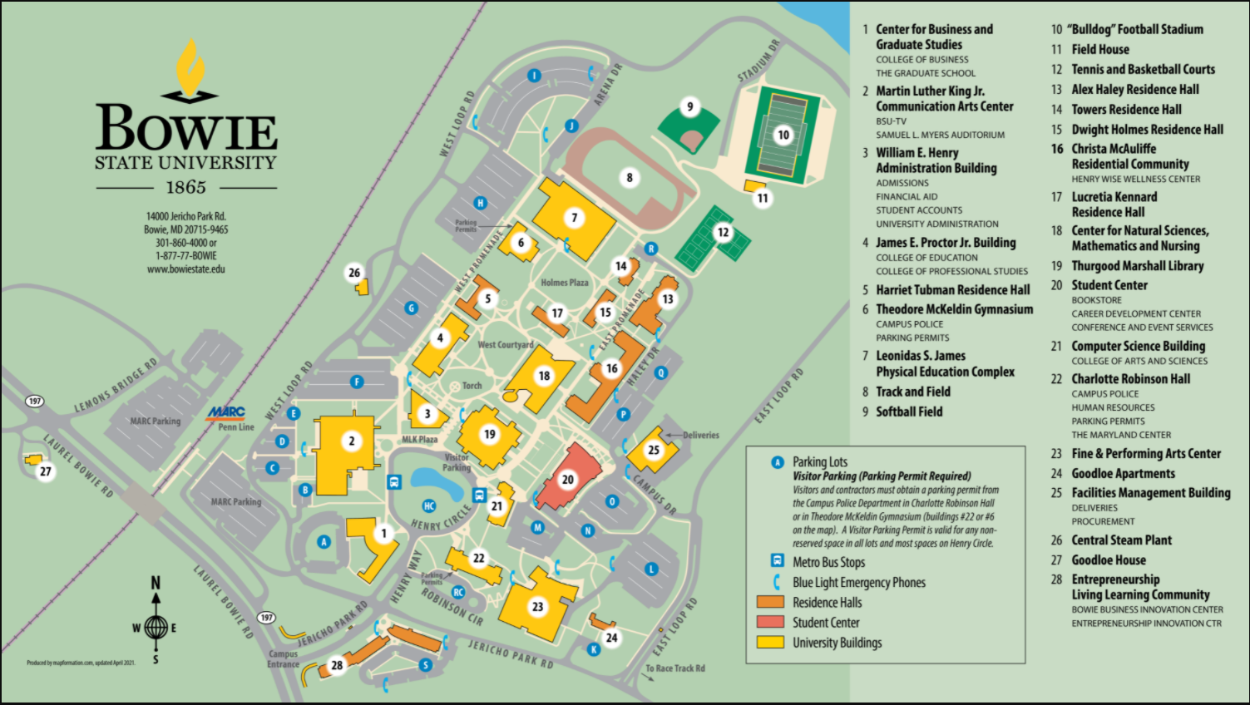
Campus Map
Notes:
Home›
Admissions & Aid›
Visit Us›
Campus Tour
Please visit the website to enjoy our interactive virtual tour of the beautiful Bowie State University campus and scroll through the slideshow below.
https://bowiestate.edu/admissions-and-aid/visit-us/campus-tour.php

Slide 48
B.E.E.S. (Bowie Electronic Emergency System)
The Police and Department of Public Safety encourages all employees to register with BEES to enhance your awareness and add an extra layer of safety
BEES is an electronic alert system that allows the university to send instant alerts via text and email advising of weather alerts, emergency or exigent occurrences which affect the campus community
Sign up to receive instant alerts to stay safe during inclement weather and other campus emergencies.
Contact: Lavel Jones,
Program Management Specialist,
(301) 860-4050
Notes:
Alerts about: Public Safety, inclement weather updates affecting alternative school hours
Some cell phone charges for text messaging may apply depending on your carrier.
Bees will only send emergency messages.
Problems while registering, please call Lavel Jones (301) 860-4050

Slide 49
New Hire Checklist
Employee/Network ID (provided today)
Your EMPLID provides access to your office computer and many web-based applications, and university services including:
PeopleSoft (Bowie Online Services)
E-mail, Calendar, and contact management (Outlook), OneDrive, SharePoint
Timesheets
Blackboard (online learning system)
Network file storage drives
Bowie card (Bulldog Card Office – Student Center)
Email/Intranet use (campus log-in, password)
HR sends info to DoIT
Access is granted through your department
Campus news (Automatically enrolled)
Broadcast emails
BSYOU e-Newsletter

Slide 50
Quick Reference Guide
Parking: The Office of Public Safety *operates 24 hours a day
Campus Safety: LaVel Jones 2-4050
Payroll: Web time Sandra Lockett 2-3483
Equity Compliance:
Sexual Harassment/Title IX: Adonna Green 2-3442
Labor & Employee Relations: Robert Enderle 2-3459
Department of Information Technology (DoIT): helpdesk@bowiestate.edu 2-4357
Help Desk
Telecommunication:
Telephone: Alona Turner 2-4106
Operational: Conference Services, Procurement, Facilities Management, Student Center (respectively) Booking a Conference Room: Annette Wedderburn 2-3839 Using a BSU Vehicle Robert Chiles 2-4215 Keys Facima Cardosogendreau 2-4190 Bulldog Card Jatina Cooke 2-3793
Bookstore Joshua Gunn 2-4350

Slide 51
Bulldog Card
The Bowie State University Bulldog Card is the official campus identification card for Faculty and Staff.
It can be used to…
Print/check-out library books
Load money for use on campus
Contact: Auxiliary Services Jatina Cooke, Student Center Manager jcooke@bowiestate.edu
Student Center, STE 1025 (#20 on the map)
(301) 860-3792
bulldogcard@bowiestate.edu
Notes:
The Bulldog Card is Bowie State University’s official ID for faculty, staff, and students.
Your Bulldog ID is a lot more than just a piece of personalized plastic. Here's where and how you can use your card.
As an identification card
As a meal card
Campus retail outlets
Paying fees (graduation, parking, etc.)
Buying books and apparel at the Bookstore
Print/Check out library books
Allocating Financial Aid
Vending Services (beverage and snack machines)
New Employees
All eligible employees are required to have a Bulldog Card while on campus. In order to receive a Bulldog Card, new employees must
Email a headshot to bulldogcard@bowiestate.edu (you’ll receive notification when ready for pickup)
Produce a copy of their New Employee Identification Card Memorandum completed by the HR Department (new employees or 1st issue)
Produce photo identification (government-issued ID, driver’s license, passport, etc.)
Please bring all documents to the Bulldog Card Office/Office of Auxiliary Services, on the first floor of the Student Center, Room 1025.

Slide 52
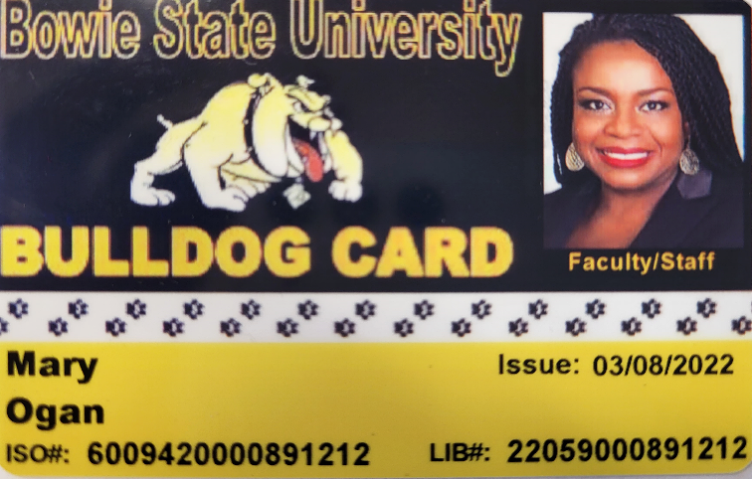
Bulldog Card
All faculty, staff and students are required to display their BSU ID while on campus.
The process to receive a BSU ID card:
Email your headshot photo bulldogcard@bowiestate.edu
Submit a color photo (taken within the last 6 months)
Use a clear image of your face. Do not use any filters
Have someone else take your photo (No selfies)
Remove eyeglasses for your photo
Use a plain white or off-white background.
You will receive an email once your BSU ID card is ready for pick-up from the Bulldog Card Box Office.
The office is located on the 1st floor of the Student Center
Open from 8:30 am -4:30 pm, Monday - Friday.
Contact: Auxiliary Services Jatina Cooke, Student Center Manager jcooke@bowiestate.edu
Student Center, STE 1025 (#20 on the map)
(301) 860-3792
bulldogcard@bowiestate.edu

Slide 53
Required Training
Topic | Audience | Contact | Timeline
Financial Disclosure Report (completed and submitted) | Directors and above |  | By April of each year
Maryland Public Ethics Law | Public Steward (VP, AVP, Directors…) | BSU-HR/State Ethics Commission Mary Ogan, mogan@bowiestate.edu | 6 months of hire
How to Conduct a Successful Performance Management Process, (PMP) Review | Managers and Supervisors | Office of Human Resources Mary Ogan, mogan@bowiestate.edu | Start of PMP cycle
Information Security Awareness | All employees | Division of Information Technology, (DoIT) helpdesk@bowiestate.edu | 6 months of hire and as requested by DoIT
New Employee Orientation | All employees | Office of Human Resources Anjanette Evans. aevans@bowiestate.edu Mary Ogan, mogan@bowiestate.edu | 1st day of hire
Requisitions and Purchase Order Training | Administrative Assistants, Clerical Staff, Staff Assistant and others as appropriate | Office of Procurement Joi Schumott, jschumott@bowiestate.edu | 6 months of hire
Sexual Harassment in the Workplace | All employees | Office of Equity Compliance Adonna Green agreen@bowiestate.edu | 6 months of hire
Supervisory Development Seminar | Managers and Supervisors | Office of Human Resources Mary Ogan, mogan@bowiestate.edu | 6 months of hire
Notes:
you will learn what information security is as well as what your responsibility is to help ensure that the principles are applied within your organisation.

Slide 54
Staff Council and You
Staff Council is a governance group that collectively represents
(with very few exceptions) employees who are not members of any collective bargaining unit.
What they do?
Staff Council addresses issues concerning working conditions and other matters that pertain to the University staff.
Meeting Times 3rd Thursday of each month (except in the summer) from 10 am – 11:30 am in the Student Center, unless otherwise noted. Attendance is open to University designated BSU Staff Council Members Only. The meeting time is from 10:00 am until 11:30 am.
Contact Person
George Jones, Chair (301) 860-3228 gjonesjr@bowiestate.edu
Staff Council does not meet during the summer months

Slide 55
Faculty Organizations
There are 2 faculty organizations that represents interests in
the shared governance arena at BSU. Both are open to all faculty.
Faculty Senate – is the faculty governance body at Bowie State.
Meet monthly, 3rd Thursday at 3:00 p.m. during the academic year.
Membership is comprised of elected and appointed representation from every dept. and at-large members from each college.
Any faculty member is welcome to attend and participate in discussions during Faculty Senate meetings, however, voting is limited to Senators.
2022-24 Chair - Dr. Tyesha N. Burks, Associate Professor, Department of Natural Sciences (tburks@bowiestate.edu)
Faculty Association - is the plenary body of the faculty
Meetings are held at least once per semester and are open to all members of the University Community.
Please contact your departmental or at-large faculty representative with any issues or concerns you would like addressed by the faculty body.
Visit the Faculty Senate webpage
To download a copy of the faculty handbook.

Slide 56
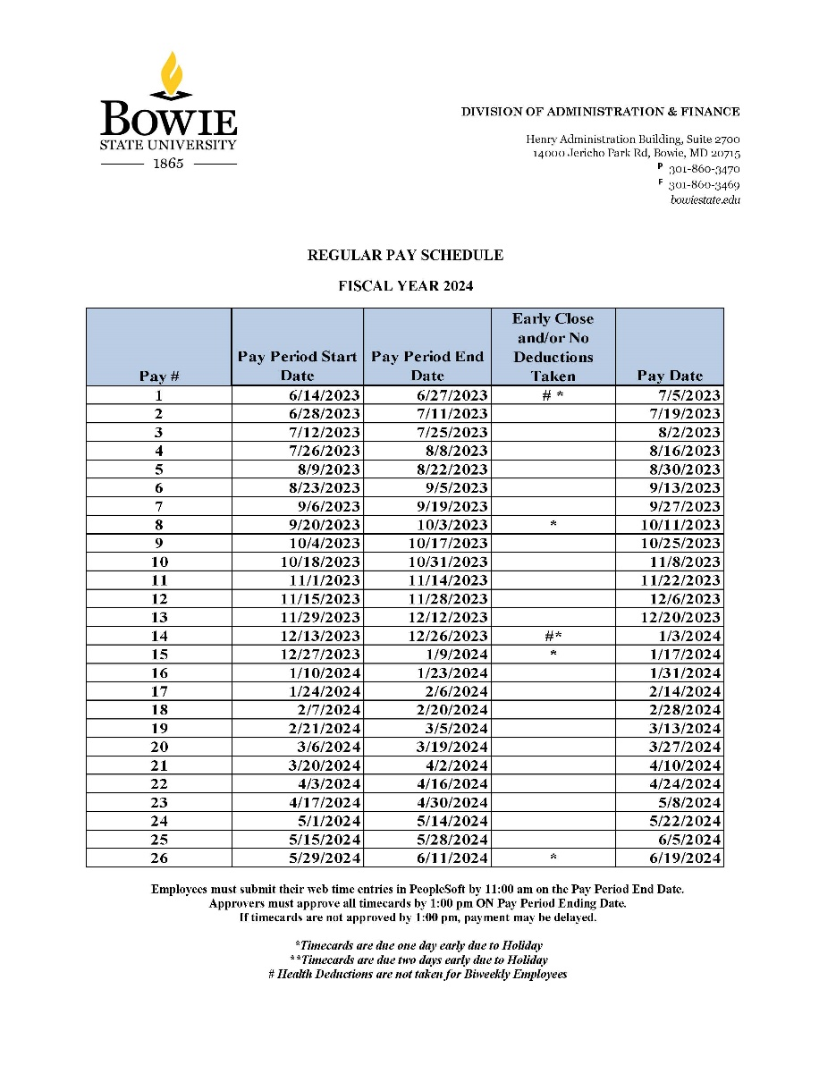
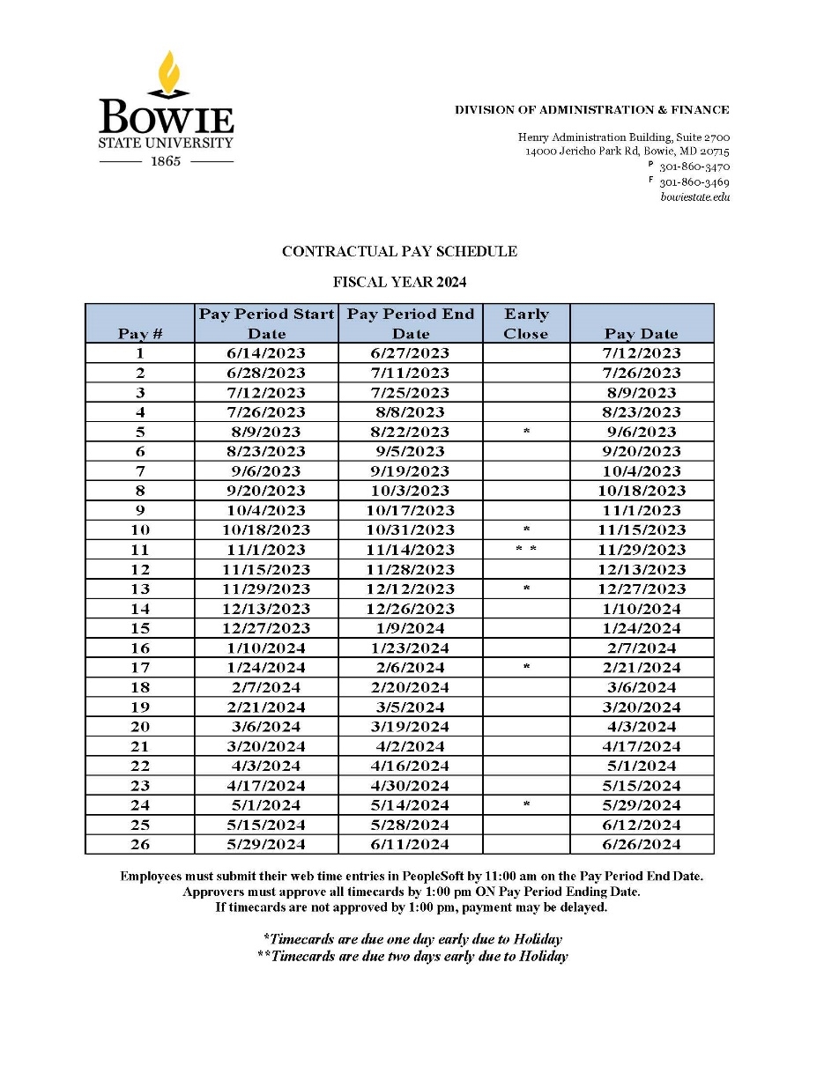
Pay Schedules
Notes:
Fdfj
The Comptroller's Office and the Central Payroll Bureau are excited to offer the new Payroll Online Service Center to provide services that have been requested by state employees.

Slide 57
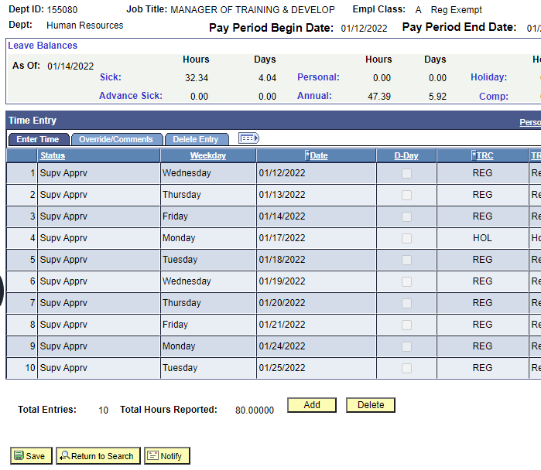
Timesheets
Timesheets for all employees (Regular and Contractual) are due no later than 11:00 a.m. on the pay period end date.
Employees
Once you enter your time into the system, the status will indicate “Needs Approval”
Next, you must confirm that your supervisor has approved your timesheet
Once your supervisor has approved your time, the status will display “Supervisor Approved”.
Approvers
Timesheet approvers must approve their employees' timesheets by 1:00 p.m. on the pay period end date.
If employees' timecards are not complete and approved on time, their pay may be delayed to the next pay period.
For questions, do not hesitate to get in touch with the following:
• Payroll at payroll@bowiestate.edu
• Ms. Sandy Lockett at llockett@bowiestate.edu
• Mrs. Jonita Leonard at jkleonard@bowiestate.edu
Notes:
Fdfj
The Comptroller's Office and the Central Payroll Bureau are excited to offer the new Payroll Online Service Center to provide services that have been requested by state employees.

Slide 58
MyBSU Website
To access your Peoplesoft electronic timesheet
www.bowiestate.edu
MyBSU
Human Resources Services
Notes:
Fdfj
The Comptroller's Office and the Central Payroll Bureau are excited to offer the new Payroll Online Service Center to provide services that have been requested by state employees.

Slide 59
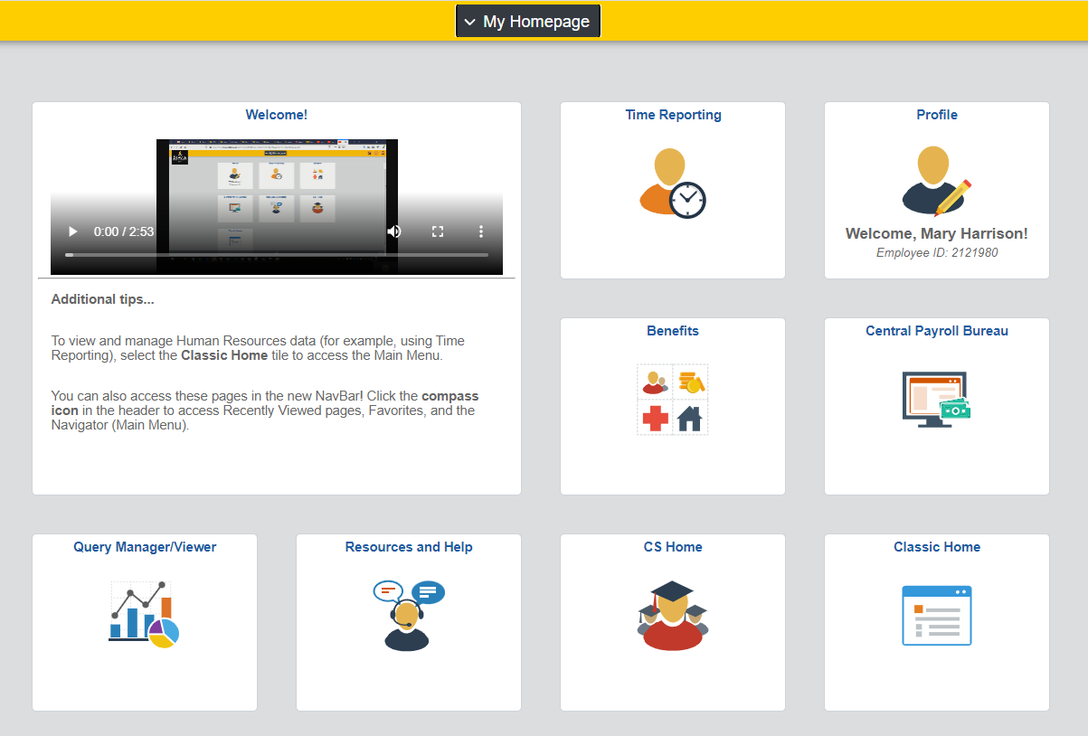
Human Resources Services
Notes:
Fdfj
The Comptroller's Office and the Central Payroll Bureau are excited to offer the new Payroll Online Service Center to provide services that have been requested by state employees.

Slide 60
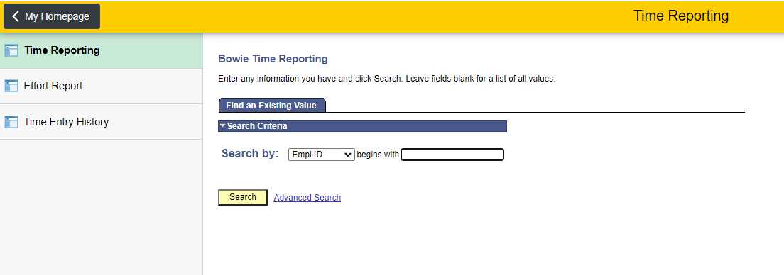
Timesheets
To access your Peoplesoft electronic timesheet
Type your Empl ID in the box
Click search
Notes:
Fdfj
The Comptroller's Office and the Central Payroll Bureau are excited to offer the new Payroll Online Service Center to provide services that have been requested by state employees.

Slide 61
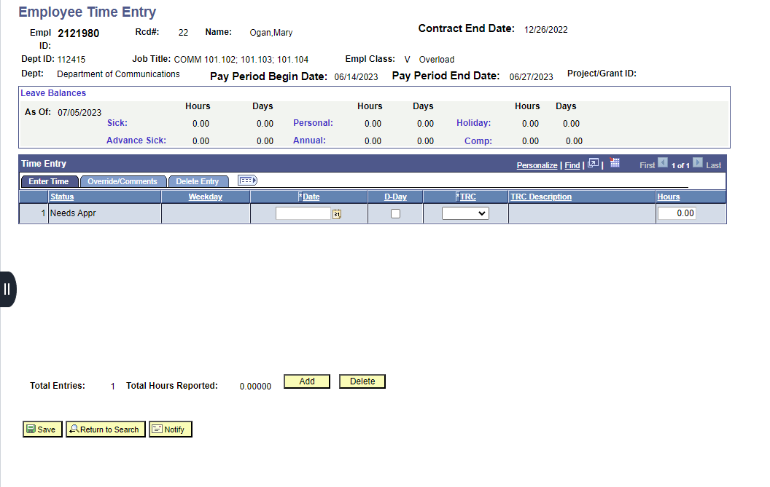
Timesheets
Notes:
Fdfj
The Comptroller's Office and the Central Payroll Bureau are excited to offer the new Payroll Online Service Center to provide services that have been requested by state employees.

Slide 62
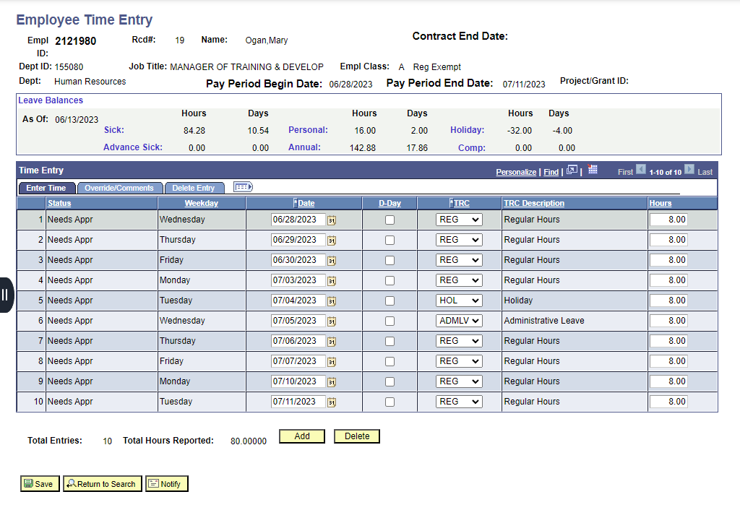
Timesheets
Notes:
Fdfj
The Comptroller's Office and the Central Payroll Bureau are excited to offer the new Payroll Online Service Center to provide services that have been requested by state employees.

Slide 63
Managing Payroll Information
The Comptroller of Maryland and the Central Payroll Bureau offer a Payroll Online Service Center (POSC) for State employees to manage their payroll information.
1st time users are required to sign up online to setup a POSC account (This requires some personalized data found on your 1st pay stub).
You may access to payment information such as:
Pay stub information
W2 data
Change/update direct deposit banking information
Online submission of address updates
W4 Withholding or change of address
1st paycheck will be a paper check mailed to you at your home address.
You can use the information on the check to generate a Logon ID and Password , that will be used each subsequent time you access the POSC.
2nd paycheck should be direct deposit (you must enroll). *Complete the direct deposit form (type on the pdf, print, and then sign with a ‘wet’ signature.)
Direct link: Human Resources Services
Contact: Sandra Lockett Payroll Manager (301) 860-3483
Notes:
Fdfj
The Comptroller's Office and the Central Payroll Bureau are excited to offer the new Payroll Online Service Center to provide services that have been requested by state employees.

Slide 64
Human Resources Services
To access the Central Payroll Bureaus POSC
www.bowiestate.edu
MyBSU
Human Resources Services
Central Payroll Bureau
POSC
Notes:
Fdfj
The Comptroller's Office and the Central Payroll Bureau are excited to offer the new Payroll Online Service Center to provide services that have been requested by state employees.

Slide 65
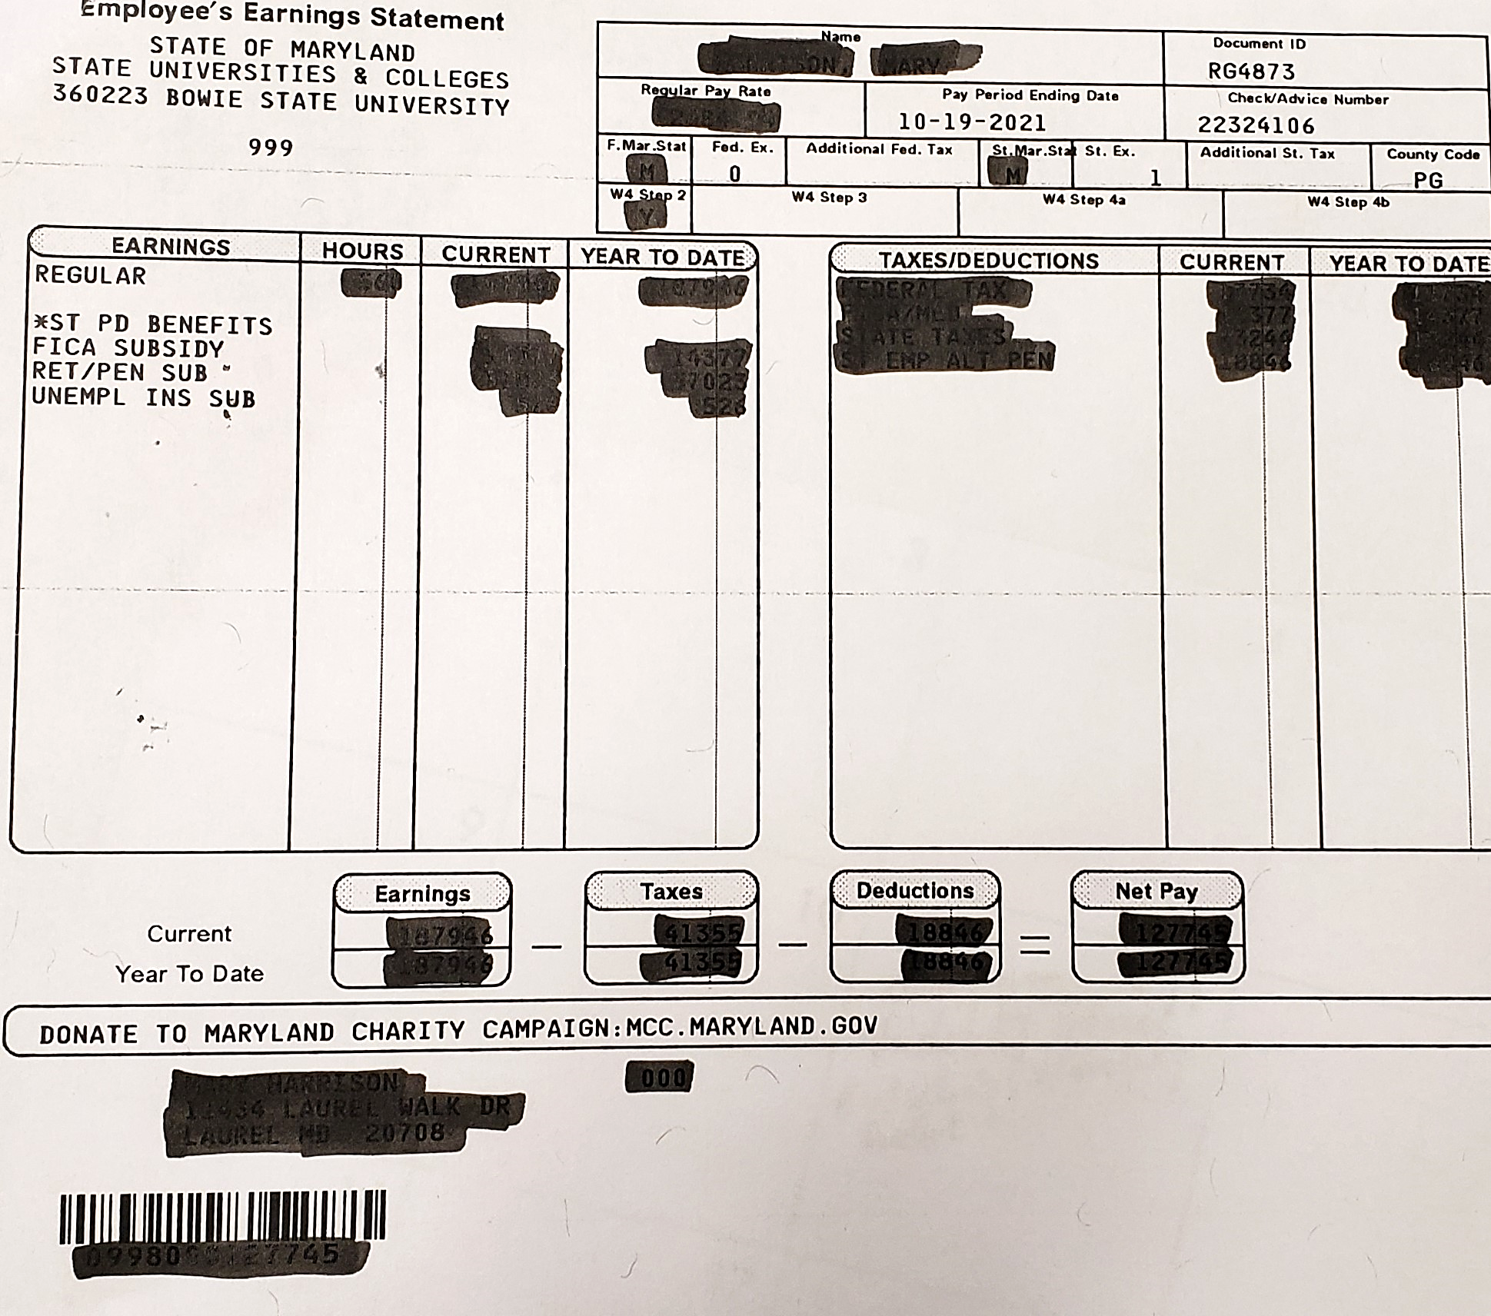
How to Sign Up with the Payroll Online Service Center (POSC)
Go to the POSC website and choose Sign-Up
To complete the SignUp process and establish a Logon ID & Password, you will be required to supply the following information:
Social Security Number
Date of Birth
BSU Agency Number (360223)
Check /Advice Number (found on the top right corner of your paper check paystub)
It takes less than 5 minutes to setup.
If you have any trouble, please send an email to
• Payroll at payroll@bowiestate.edu
• Ms. Sandy Lockett at llockett@bowiestate.edu
• Mrs. Jonita Leonard at jkleonard@bowiestate.edu
Notes:
Fdfj
The Comptroller's Office and the Central Payroll Bureau are excited to offer the new Payroll Online Service Center to provide services that have been requested by state employees.

Slide 66
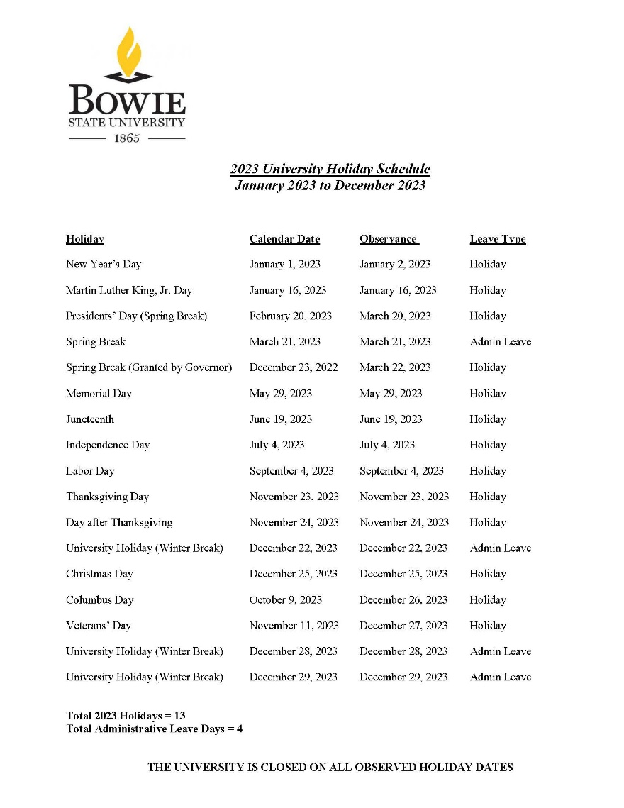
BSU Holiday Schedule
13 holidays in 2023
4 Administrative leave days
The University is closed on all observed holiday dates

Slide 67
BSU Holiday Schedule
Employees hired after a Holiday which has past, must use personal or annual leave to compensate for unearned holidays.
Employees who earn leave (Regular and Contingent II only) should use Holiday Leave (HOL) for December 25, 26, and 27, 2023.
Date | Day | Leave Type | Leave Code | Actual Holiday Observed
03/22/2023 | Monday | Holiday |  | Presidents’ Day (Spring Break)
03/21/2023 | Monday | Holiday | ADL | Spring Break
03/22/2023 | Tuesday | Holiday | HOL | Spring Break (Granted by Governor)

Slide 68
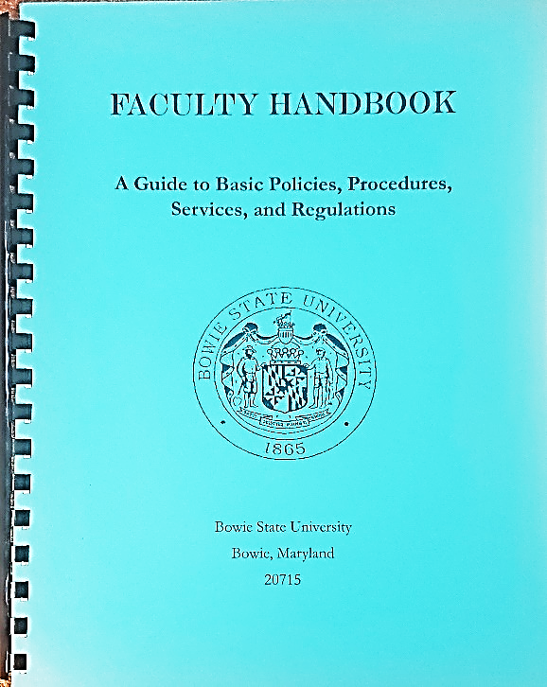
Employee/Faculty Handbook
Guide to Basic Policies, Procedures, Services and Regulations
Available electronically

Slide 69
Message from the Parking Office
Parking permits must be displayed to park on campus.
2-ways to pay
Direct payment
Payroll deductions (bi-weekly)
Pay at Student Accounts
Permits obtained
McKeldin Gym (preferred)
Communications Office (Robinson Hall)
Lot Designation: Permit designates the lot(s) you may park
There is a 20% discount for qualifying green cars.
Notes:
Parking permits must be obtained and displayed at all times while parking on campus.
After payment a valid receipt from Student accounts is taken to McKeldin Gym or DPS Communications Office in Robinson Hall
Please allow up to 30 business days to see the deduction
$20 for a second permit or list both vehicle tag numbers on application form
20% discount on permit cost on energy efficient cars. Must show proof of Energy Efficient Qualifying vehicle visit www.greenercars.org after scoring 40 or higher as rated by ACEEE.

Slide 70
Parking Authorization Form
Full time employees can receive payroll deductions
Can sign up in August (memo will go out)
After enrollment, please allow up to 30 days to see deductions
$5.25 Bi-weekly ($105 annually)
Contact: Lavel Jones,
Program Management Specialist,
(301) 860-4050

Slide 71
Parking Authorization Form
The Pre-Tax Deduction Authorization Form must be completed before the beginning of the fall semester by all qualified full-time faculty and staff to obtain a yearlong parking permit (September 1 – August 31).
Bi-weekly deductions will be made for a total of 20 pay periods beginning September and ending in May. The deduction will appear on your paystub as 20-PAY PARKING.
New employees hired after September will begin their payroll deduction on the next payroll cycle after completion of the Authorization Form. New employees hired from June to August of each year will be required to purchase a short-term permit through the Student Accounts Office.
Once payroll deductions have been initiated by the State Central Payroll Bureau, there will be no refunds. The payroll deduction will automatically renew in July of each year and parking fees can be amended in accordance with future fee changes. An employee may also select to cancel this payroll deduction at this time by checking the “Cancel Box” on the Deduction Authorization Form.
Deductions end upon separation of service to the University It is the employee’s responsibility to return the parking permit to the Parking Office before the Clearance Certificate Form will be completed by Campus Safety.

Slide 72
Parking Authorization Form
Valid Parking Permit
A permit is valid only when it corresponds to the license plate number registered at the BSU Parking Office;
displayed properly
Visible
Not suspended, altered, or revoked.
A parking permit is transferable only to vehicles listed on the registration card. If the permit is affixed to an unregistered vehicle, the owner of the vehicle will be subject to a $100 fine, and the owner of the permit is subject to revocation of parking privileges (with no refund). All permits must hang from the rearview mirror with the expiration date visible from the front of the vehicle. Motorcycles must be registered.
Special Medical Arrangements
To utilize a handicapped space on campus, a driver must purchase a BSU parking permit and meet the State requirements to obtain a disability placard or handicap license plate.

Slide 73
Parking Authorization Form
Discount on Energy Efficient Cars
Drivers with a vehicle scoring 40 or higher as rated by American Council for Energy-Efficient Economy receive a 20% discount on the rates above. See greenercars.org to find out if you qualify.
Type | Fee
Resident Student | $100.00
Commuter Student | $93.00
Faculty/Staff | $105.00
Faculty/Staff reserved | $145.00
Faculity/Staff semester only | $65.00
Student Semester only | $60.00
Monthly | $50.00
Fall 2022/Spring 2023
NOTE: All fees are subject to change without prior notice.

Slide 74
Parking Rules and Regulations
Dept. of Public Safety Parking Rules and Regulations Booklet
Contact: Lavel Jones, Program Management Specialist,
(301) 860-4050

Slide 75
Percipio e-Learning Platform
Percipio is a huge library of video training courses taught by respected professionals . Thousands of courses, tutorials and learning assets such as eBooks, test prep, and job aids etc.
Free unlimited access
Available 24/7
May be used to support blended learning
Thousands of videos and tutorials (eg. Software, creative arts, business skills, and more)
Notes:
Enhance your IT skills or learn something new, Bowie State University offers free unlimited online access to Lynda.com 24/7
Thousands of videos and tutorials all in one place
Blended learning

Slide 76
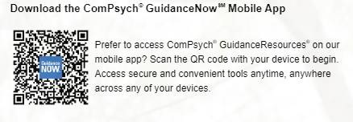
Employee Assistance Program
Your GuidanceResources® Employee Assistance Program provides counseling and other services to help you. This program is confidential and free to you and your family members who live with you 24-hour service
Legal Guidance
Confidential Emotional Support
Work-Life Solutions
Financial Resources
Online Support
Life coaching
Wellness webinars
Available per house, not per family member
Access online at guidanceresources.com
Web ID: USMEAP
Download App: GuidanceNow

Slide 77
Henry Wise Wellness Center
Established for students, however will offer select service such as:
Asprins
Band aids
Call emergency or ambulance (if needed)

Slide 78
Vaccination Cards
BSU members can upload pictures of immunization records through:
The Wellness Center patient portal or
Email the image to the Wellness Center at hwwc@bowiestate.edu
The Wellness Center cannot accept any digital records that require the employees log in credentials.
Once the a new employee's Peoplesoft registration data is completed thru DoIT /HR, the employees data will be interfaced into the Wellness Center's electronic medical system. Which will take a few days.
You may obtain free Rapid take-home tests from the Library circulation desk

Slide 79
Questions

