Slide 1
Cognitive Behavioral Techniques for Assisting Students
February 14
2023
Dr. Marianne Moore, CETL Fellow
College of Professional Studies

Slide 2
Introduction
Students tell us that they “can’t manage” in school
Faculty see more and more students with serious challenges with anxiety and depression
Some students “check out” and are not seen in class

Slide 3
What have you seen?
What challenges have you had while teaching?

Slide 4

Introduction
What was the author of Proverbs referring to?
How could it relate to students?

Slide 5
Background
Grew out of behavioral theories in the 40s and 50s.
Used to deal with persistent fears
Aaron Beck noted common thought patterns in clients.
Internal dialogues were noted.
Clients weren’t always aware of the thoughts.
He theorized that these patterns could be changed

Slide 6
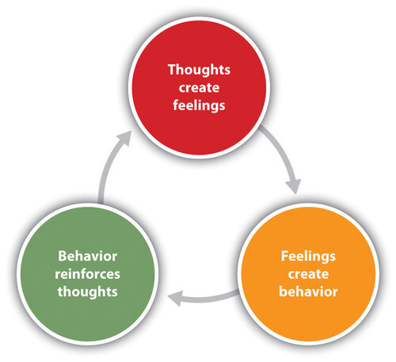
Three Components
Cognitive reframing comes from cognitive behavioral therapy (CBT)
Based on the relationship between thoughts, feelings & behavior

Slide 7
Three Components-Thoughts
Thoughts are ideas we have
Connect to physical feelings

Slide 8
Three Components-Feelings
People can have names for the feelings
Some feelings can seem like physical problems

Slide 9
Three Components-Behavior
Behavior can reinforce thoughts
What behaviors can you think of?

Slide 10
Cognitive Reframing
A way to identify and then change the way situations, experiences, events, ideas, and/or emotions are viewed.
Learn to adopt a new way
Can be positive or negative

Slide 11
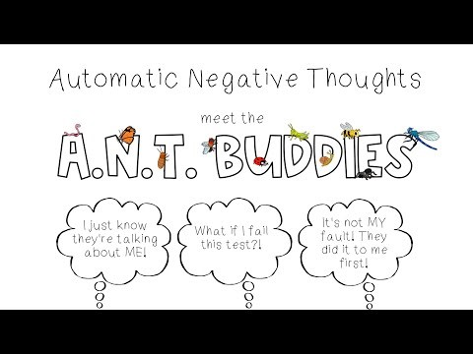
What are automatic thoughts?
Developed as “shortcuts”

Slide 12
Dealing with it?
Catch it-check it- change it
Turn the thought into a statement
Evidence for? Evidence against?
Is there another explanation?
Identify the worst and the best
What would I tell a friend to do?

Slide 13
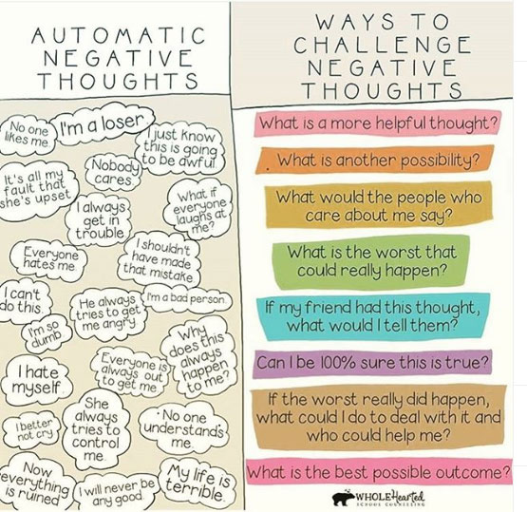
Dealing with it?
What effect does believing this thought have on me?
What positive action can I take now?

Slide 14
Getting started
Changing thoughts, behavior, or feelings results in changes in the other components.
Identify general issues first
Specifically, what does it look like for the student?
Are there certain thoughts, actions, and emotions that go along with the issues you identified?
Are there 1 or 2 things that you want to change? Be specific
Any specific things you want to be able to do?

Slide 15
Techniques
How to help your students

Slide 16
Techniques
Listen to your student
What was high school like?
Have you ever felt challenged in school before?
Relationships help students feel safe in learning.
Ask about study habits

Slide 17
Negative filtering
Does the student discuss negatives?
Ask about a positive experience
Suggest they work on finding positives to balance their view

Slide 18
All or Nothing
Specifically, what are the two extremes?
Are there possible outcomes between the extremes?
What can the student do to make progress to a more positive outcome?

Slide 19

Catastrophizing
Treating an unpleasant event as a disaster
What will you do if the “worst” happens?
What challenges have gone well previously for the student?

Slide 20

Mind reading
Focused on knowing others
Doesn’t know themselves

Slide 21
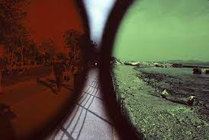
Discounting the positives
Similar to negative filtering
Active rejection of the good things

Slide 22
Emotional reasoning
If you experience a negative emotion, you conclude that you are a bad person.
It’s the condition of being strongly influenced by your emotions & assuming that they indicate objective truth

Slide 23
Conclusion
We learned about cognitive behavioral techniques
We saw a video about the A.N.T buddies and automatic negative thoughts
We explored ways to stop negative thoughts
Automatic negative thoughts should be examined & challenged
Catch it-check it- change it

Slide 24
Conclusion
Balance negative thoughts with positive ideas
All or nothing-identify whatever positive steps can be taken
Introduce balance with catastrophizing
Mind reading: Check with the person who is the object of the student’s concern- a partner, peer or faculty/professor
Discounting positives: practice accepting compliments
Emotional reasoning: validate reality with a trusted person

