Slide 1
Spring 2025
Faculty/Staff Institute

Slide 2
Agenda Items
FY 2025 Budget Update
FY 2026 Budget Update (Looking Ahead)
Page 2

Slide 3
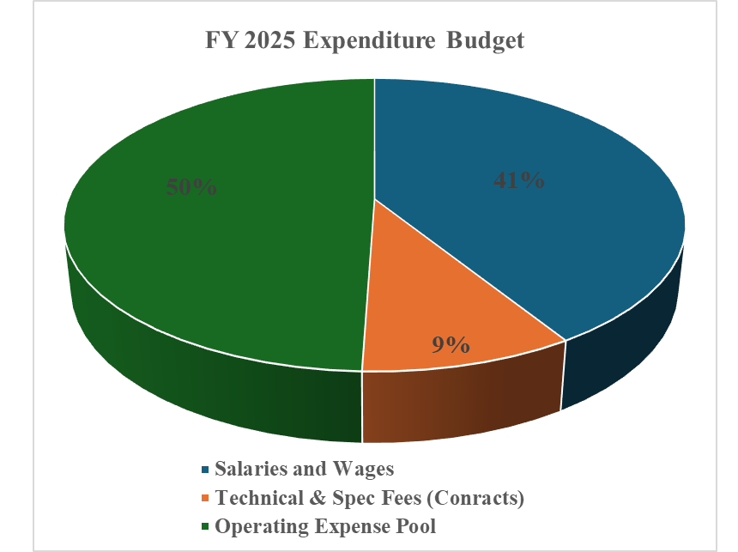
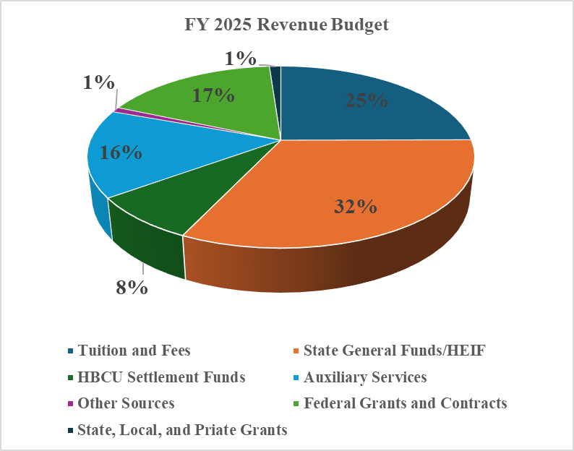
FY 2025 University Budget
Page 3

Slide 4
FY 2025 Budget Update
University budget included reductions to State Appropriations and HBCU Settlement Funds, totaling $4.2M
University budget consist of 1% fund balance goal per USM requirement
Increased 6 FTE for regular staff PIN positions associated with opening of new MLK Communications Arts & Humanities building
Funding for COLA and/or Merit for faculty and staff
Increase in funding totaling $2.8M for approved initiatives such as new facilities support (Humanities), adjuncts, program growth, financial aid, technology enhancements, campus safety enhancements
Page 4

Slide 5
FY 2025 Budget Update
University budget assumes enrollment headcount of 6,513 for fall 2024 and headcount of 5,862 or 90% for spring 2025
Increase Turnover Rate additional 2% (2.5% to 4.5%) to balance budget
Experienced Fall 2024 enrollment shortfall compared to budget
Anticipate Spring 2025 enrollment shortfall compared to budget
Outstanding Student Debt
Page 5

Slide 6
FY 2026 Budget Update
Revenue shortfalls aligned with Governor Moore’s budget Budget Highlights Fiscal Year 2026
Estimated 5% State General Funds reduction
Anticipating HBCU Coalition Funds reduction
Anticipating reduction in enrollment
Tuition and Fee increases unresolved
Continue to address outstanding student debt
Overall, anticipating an estimated $7M budget reduction over FY 2025
Page 6

Slide 7
Budget Development Process Calendar
Timeline | Dates | Task
Aug-Sept | August | USM provides Bowie with specific budget instructions and information for submission of next year’s budget request (General Funds, Tuition Rate, Institutional Mandatories, etc.)
 | August | Budget Office obtains preliminary enrollment numbers and credit hour mix from Institutional Research for development of the University’s budget request
 | September | A preliminary fiscal year budget request is prepared in accordance with USM instructions, preliminary enrollment numbers, preliminary initiatives, and the current year base budget
 | September | The preliminary fiscal year budget request is prepared for the State and entered into the Budget Application System (BAS)
Nov-Jan | November | Draft Tuition, Mandatory Fees, Room and Board rates are reviewed through shared governance process (SGA, GSA, & University Council)
 | December | If applicable, adjustments are made to the preliminary fiscal year budget request based on information from USM
Jan-Mar | January | Governor approves fiscal year budget request and forwards to Department of Legislative Services (DLS)
 | January | Receive several fiscal impact statements from USM regarding pending legislation that may have impact on higher education institutions in the State
 | January | DLS prepares an assessment of BSU and submits questions/areas of concerns
 | January | Conduct Mid-Year Expenditure Review with VPs and/or President – Re-allocation of one-time funds recommended, if appropriate, to align with strategic priorities
 | February | If applicable, Budget Hearings with the Department of Budget and Management (DBM) are held. Testimony is prepared for President to defend upcoming fiscal year budget proposal
Page 7

Slide 8
Budget Development Process Calendar
Timeline | Dates | Task
 | February | If applicable, President testifies before the House/Senate subcommittees
 | February | Tuition, Mandatory Fees, Room and Board rates are submitted to Board of Regents (BOR) for approval
 | February | VPAF provides mid-year budget update to the campus community
 | February | President and Cabinet members establish University priorities for Outlying FY
 | February | Cabinet finalizes enrollment numbers for development of University’s upcoming fiscal year working budget
 | March | Departments begin developing initiatives for review based on instructions from their division/department heads
Apr-Jul | April | All departmental initiatives are due to their respective division/department heads (VP) for review
 | May | All proposed initiatives are due to the Budget Office from division VPs
 | May | Cabinet reviews submissions to ensure initiatives are aligned with BSU’s Strategic Plan and FY Priorities
 | May | VPAF host campus budget forum
 | May | If appliable, Cabinet continues to review initiatives for approval
 | June | Budget Office begins the process of reconciling and preparing the working budget for use in the financial system
 | July | Budget Office informs the campus community that budgets are available
Page 8

